Slide 1
APL 745: Deep Learning in Mechanics
Topics:
Contd…Convolutional Neural Networks
Fully-connected layers as convolutions
Toeplitz matrices and convolutions = matrix-mult
Transposed convolutions
Sitikantha Roy
IIT Delhi

Slide 2
Plan for Today
(Contd …) Convolutional Neural Networks
Fully-connected layers as convolutions
Toeplitz matrices and convolutions = matrix-mult
Transposed convolutions

Slide 3

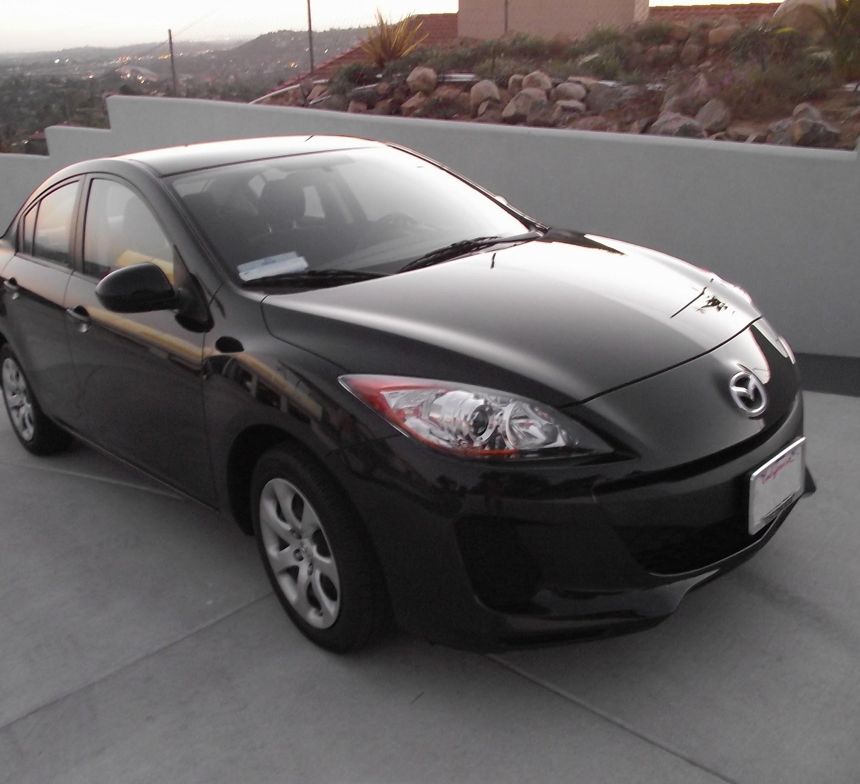
Fully Connected Layer (FC layer)
Contains neurons that connect to the entire input volume, as in ordinary Neural Networks
Notes:
Car image is photo taken by Lane McIntosh, permission to use.

Slide 4
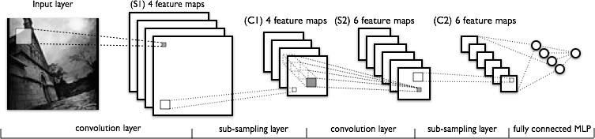
Convolutional Neural Networks
Image Credit: Yann LeCun, Kevin Murphy

Slide 5
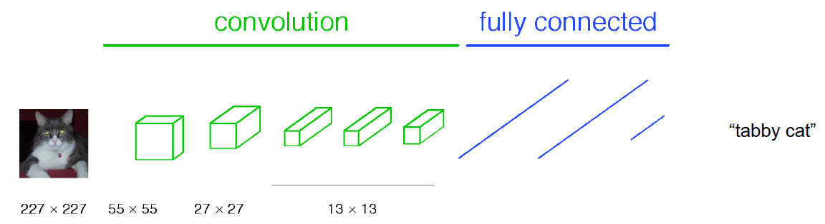
Classical View

Slide 6
C₂ hidden units
NxNxC₁, N small
Fully conn. layer
Slide Credit: Marc'Aurelio Ranzato

Slide 7
Classical View
Figure Credit: [Long, Shelhamer, Darrell CVPR15]

Slide 8
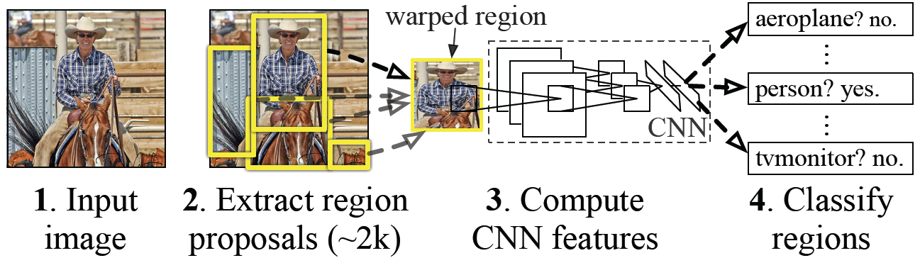
Classical View = Inefficient Conversion to detection prob

Slide 9
Classical View
Figure Credit: [Long, Shelhamer, Darrell CVPR15]

Slide 10
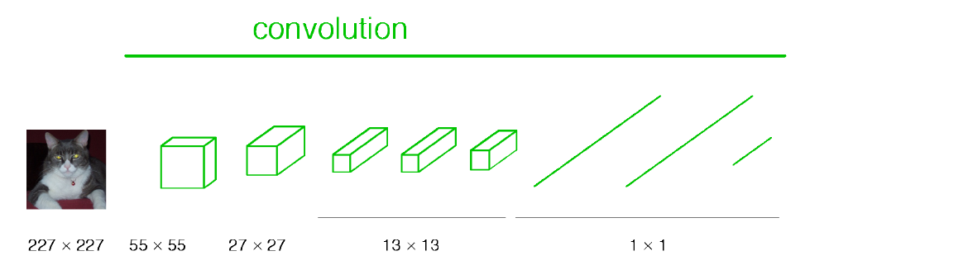
Re-interpretation
Just squint a little!
Figure Credit: [Long, Shelhamer, Darrell CVPR15]

Slide 11
C₂ hidden units /
1x1xC₂ feature maps
NxNxC₁, N small
Fully conn. layer /
Conv. layer (C₂ kernels of size NxNxC₁)
Slide Credit: Marc'Aurelio Ranzato

Slide 12
Re-interpretation
Just squint a little!
Figure Credit: [Long, Shelhamer, Darrell CVPR15]

Slide 13
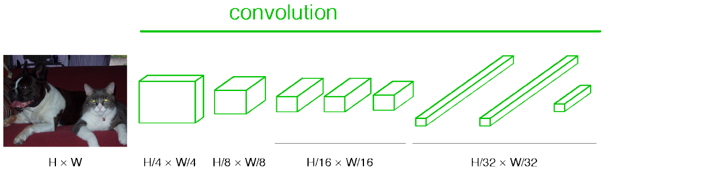
“Fully Convolutional” Networks
Can run on an image of any size!

Slide 14
Benefit of this thinking
Mathematically elegant
Efficiency
Can run network on arbitrary image
Without multiple crops

Slide 15
Plan for Today
(Finish) Convolutional Neural Networks
Fully-connected layers as convolutions
Toeplitz matrices and convolutions = matrix-mult
Transposed convolutions

Slide 16
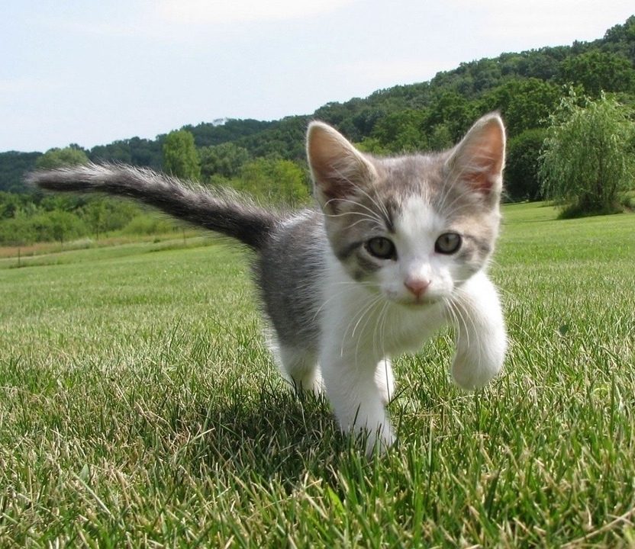
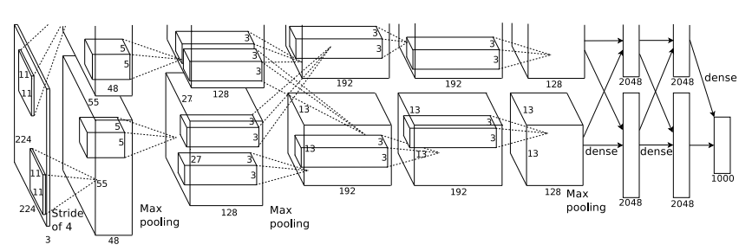
So far: Image Classification
Class Scores
Cat: 0.9
Dog: 0.05
Car: 0.01
...
Fully-Connected:
4096 to 1000
This image is CC0 public domain
Figure copyright Alex Krizhevsky, Ilya Sutskever, and Geoffrey Hinton, 2012. Reproduced with permission.
Vector:
4096
Slide Credit: Fei-Fei Li, Justin Johnson, Serena Yeung, CS 231n

Slide 17
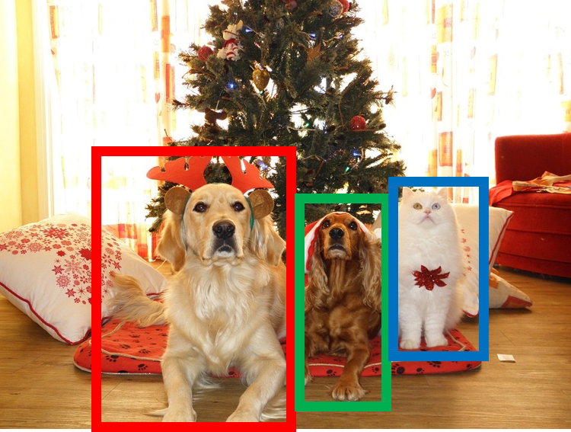
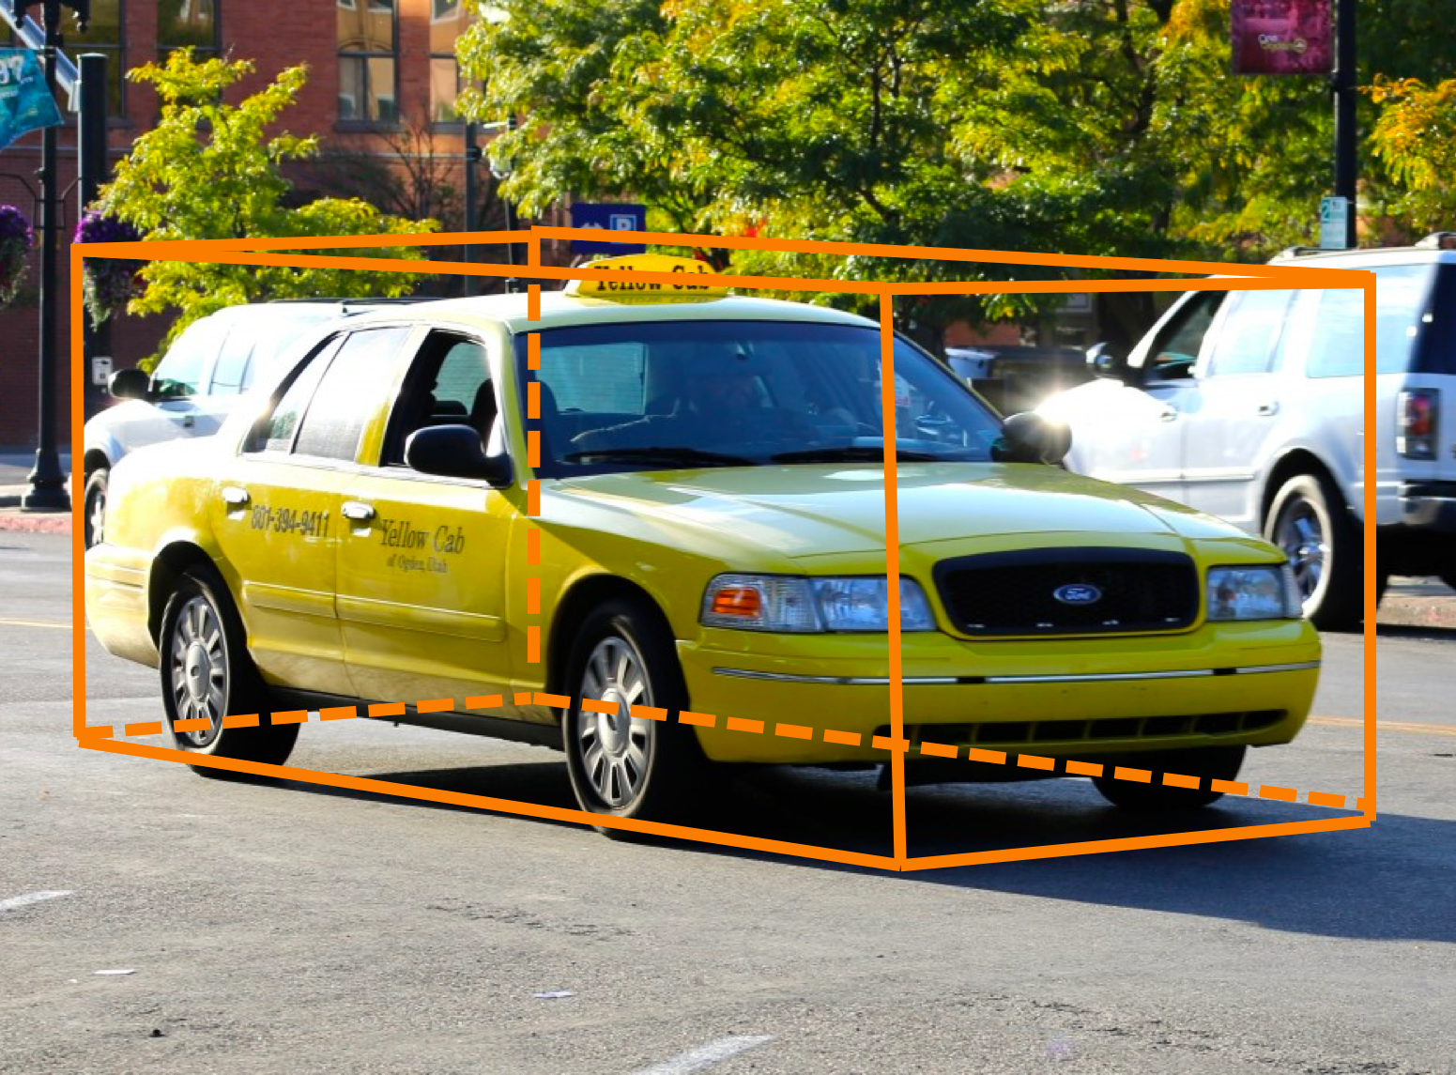
Other Computer Vision Tasks
Semantic Segmentation
2D Object Detection
3D Object Detection
GRASS, CAT, TREE, SKY
DOG, DOG, CAT
Car
Object categories +
2D bounding boxes
Object categories +
3D bounding boxes
No objects, just pixels
This image is CC0 public domain
Slide Credit: Fei-Fei Li, Justin Johnson, Serena Yeung, CS 231n

Slide 18
Semantic Segmentation
Semantic Segmentation
2D Object Detection
3D Object Detection
GRASS, CAT, TREE, SKY
DOG, DOG, CAT
Car
Object categories +
2D bounding boxes
Object categories +
3D bounding boxes
No objects, just pixels
This image is CC0 public domain
Notes:
Given this cute cat picture, the image classification task would be looking at this picture and ouput a single label cat

Slide 19
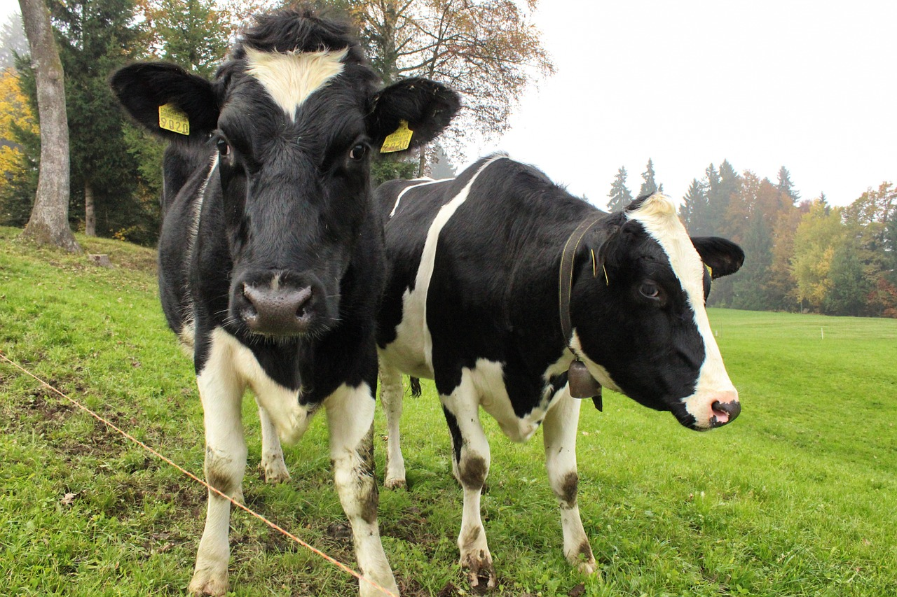
Semantic Segmentation
This image is CC0 public domain
Label each pixel in the image with a category label
Don’t differentiate instances, only care about pixels
Sky
Trees
Sky
Trees
Cat
Cow
Grass
Grass
Slide Credit: Fei-Fei Li, Justin Johnson, Serena Yeung, CS 231n

Slide 20
Semantic Segmentation Idea: Sliding Window
Extract patch
Classify center pixel with CNN
Full image
Cow
Cow
Grass
Farabet et al, “Learning Hierarchical Features for Scene Labeling,” TPAMI 2013
Pinheiro and Collobert, “Recurrent Convolutional Neural Networks for Scene Labeling”, ICML 2014
Slide Credit: Fei-Fei Li, Justin Johnson, Serena Yeung, CS 231n

Slide 21
Semantic Segmentation Idea: Sliding Window
Extract patch
Classify center pixel with CNN
Full image
Cow
Cow
Grass
Problem: Very inefficient! Not reusing shared features between overlapping patches
Farabet et al, “Learning Hierarchical Features for Scene Labeling,” TPAMI 2013
Pinheiro and Collobert, “Recurrent Convolutional Neural Networks for Scene Labeling”, ICML 2014
Slide Credit: Fei-Fei Li, Justin Johnson, Serena Yeung, CS 231n

Slide 22
Semantic Segmentation Idea: Fully Convolutional
Design a network as a bunch of convolutional layers to make predictions for pixels all at once!
Conv
Conv
Conv
Conv
argmax
Input:
3 x H x W
Predictions:
H x W
Scores:
C x H x W
Convolutions:
D x H x W
Slide Credit: Fei-Fei Li, Justin Johnson, Serena Yeung, CS 231n

Slide 23
Semantic Segmentation Idea: Fully Convolutional
Design a network as a bunch of convolutional layers to make predictions for pixels all at once!
Conv
Conv
Conv
Conv
argmax
Input:
3 x H x W
Predictions:
H x W
Scores:
C x H x W
Problem: convolutions at original image resolution will be very expensive ...
Convolutions:
D x H x W
Slide Credit: Fei-Fei Li, Justin Johnson, Serena Yeung, CS 231n

Slide 24
Semantic Segmentation Idea: Fully Convolutional
Design network as a bunch of convolutional layers, with downsampling and upsampling inside the network!
Med-res:
D₂ x H/4 x W/4
Med-res:
D₂ x H/4 x W/4
Low-res:
D₃ x H/4 x W/4
Input:
3 x H x W
High-res:
D₁ x H/2 x W/2
High-res:
D₁ x H/2 x W/2
Predictions:
H x W
Long, Shelhamer, and Darrell, “Fully Convolutional Networks for Semantic Segmentation”, CVPR 2015 Noh et al, “Learning Deconvolution Network for Semantic Segmentation”, ICCV 2015
Slide Credit: Fei-Fei Li, Justin Johnson, Serena Yeung, CS 231n

Slide 25
Semantic Segmentation Idea: Fully Convolutional
Downsampling:
Pooling, strided convolution
Design network as a bunch of convolutional layers, with downsampling and upsampling inside the network!
Upsampling:
???
Med-res:
D₂ x H/4 x W/4
Med-res:
D₂ x H/4 x W/4
Low-res:
D₃ x H/4 x W/4
Input:
3 x H x W
High-res:
D₁ x H/2 x W/2
High-res:
D₁ x H/2 x W/2
Predictions:
H x W
Long, Shelhamer, and Darrell, “Fully Convolutional Networks for Semantic Segmentation”, CVPR 2015 Noh et al, “Learning Deconvolution Network for Semantic Segmentation”, ICCV 2015
Slide Credit: Fei-Fei Li, Justin Johnson, Serena Yeung, CS 231n

Slide 26
In-Network upsampling: “Unpooling”
Nearest Neighbor
“Bed of Nails”
1 | 0 | 2 | 0
0 | 0 | 0 | 0
3 | 0 | 4 | 0
0 | 0 | 0 | 0
1 | 1 | 2 | 2
1 | 1 | 2 | 2
3 | 3 | 4 | 4
3 | 3 | 4 | 4
1 | 2
3 | 4
1 | 2
3 | 4
Input: 2 x 2
Output: 4 x 4
Input: 2 x 2
Output: 4 x 4
Slide Credit: Fei-Fei Li, Justin Johnson, Serena Yeung, CS 231n

Slide 27
In-Network upsampling: “Max Unpooling”
Max Pooling
Remember which element was max!
Max Unpooling
Use positions from pooling layer
1 | 2 | 6 | 3
3 | 5 | 2 | 1
1 | 2 | 2 | 1
7 | 3 | 4 | 8
0 | 0 | 2 | 0
0 | 1 | 0 | 0
0 | 0 | 0 | 0
3 | 0 | 0 | 4
5 | 6
7 | 8
…
1 | 2
3 | 4
Rest of the network
Input: 4 x 4
Output: 2 x 2
Input: 2 x 2
Output: 4 x 4
Corresponding pairs of downsampling and upsampling layers
Slide Credit: Fei-Fei Li, Justin Johnson, Serena Yeung, CS 231n

Slide 28
Transposed Convolutions
Deconvolution (bad name)
Upconvolution
Fractionally strided convolution
Backward strided convolution

Slide 29
Learnable Upsampling: Transpose Convolution
Recall: Normal 3 x 3 convolution, stride 1 pad 1
Input: 4 x 4
Output: 4 x 4
Slide Credit: Fei-Fei Li, Justin Johnson, Serena Yeung, CS 231n

Slide 30
Learnable Upsampling: Transpose Convolution
Recall: Normal 3 x 3 convolution, stride 1 pad 1
Dot product between filter and input
Input: 4 x 4
Output: 4 x 4
Slide Credit: Fei-Fei Li, Justin Johnson, Serena Yeung, CS 231n

Slide 31
Learnable Upsampling: Transpose Convolution
Recall: Normal 3 x 3 convolution, stride 1 pad 1
Dot product between filter and input
Input: 4 x 4
Output: 4 x 4
Slide Credit: Fei-Fei Li, Justin Johnson, Serena Yeung, CS 231n

Slide 32
Learnable Upsampling: Transpose Convolution
Recall: Normal 3 x 3 convolution, stride 2 pad 1
Input: 4 x 4
Output: 2 x 2
Slide Credit: Fei-Fei Li, Justin Johnson, Serena Yeung, CS 231n

Slide 33
Learnable Upsampling: Transpose Convolution
Recall: Normal 3 x 3 convolution, stride 2 pad 1
Dot product between filter and input
Input: 4 x 4
Output: 2 x 2
Slide Credit: Fei-Fei Li, Justin Johnson, Serena Yeung, CS 231n

Slide 34
Learnable Upsampling: Transpose Convolution
Recall: Normal 3 x 3 convolution, stride 2 pad 1
Filter moves 2 pixels in the input for every one pixel in the output
Stride gives ratio between movement in input and output
Dot product between filter and input
Input: 4 x 4
Output: 2 x 2
Slide Credit: Fei-Fei Li, Justin Johnson, Serena Yeung, CS 231n

Slide 35
Learnable Upsampling: Transpose Convolution
3 x 3 transpose convolution, stride 2 pad 1
Input: 2 x 2
Output: 4 x 4
Slide Credit: Fei-Fei Li, Justin Johnson, Serena Yeung, CS 231n

Slide 36
Learnable Upsampling: Transpose Convolution
3 x 3 transpose convolution, stride 2 pad 1
Input gives weight for filter
Input: 2 x 2
Output: 4 x 4
Slide Credit: Fei-Fei Li, Justin Johnson, Serena Yeung, CS 231n

Slide 37
Learnable Upsampling: Transpose Convolution
3 x 3 transpose convolution, stride 2 pad 1
Sum where output overlaps
Filter moves 2 pixels in the output for every one pixel in the input
Stride gives ratio between movement in output and input
Input gives weight for filter
Input: 2 x 2
Output: 4 x 4
Slide Credit: Fei-Fei Li, Justin Johnson, Serena Yeung, CS 231n

Slide 38
Learnable Upsampling: Transpose Convolution
3 x 3 transpose convolution, stride 2 pad 1
Sum where output overlaps
Other names:
-Deconvolution (bad)
-Upconvolution
-Fractionally strided convolution
-Backward strided convolution
Filter moves 2 pixels in the output for every one pixel in the input
Stride gives ratio between movement in output and input
Input gives weight for filter
Input: 2 x 2
Output: 4 x 4
Slide Credit: Fei-Fei Li, Justin Johnson, Serena Yeung, CS 231n

Slide 39
Transpose Convolution: 1D Example
Output
Input
Filter
ax
ay
az + bx
by
bz
Output contains copies of the filter weighted by the input, summing at where at overlaps in the output
Need to crop one pixel from output to make output exactly 2x input
x
y
z
a
b
Slide Credit: Fei-Fei Li, Justin Johnson, Serena Yeung, CS 231n

Slide 40
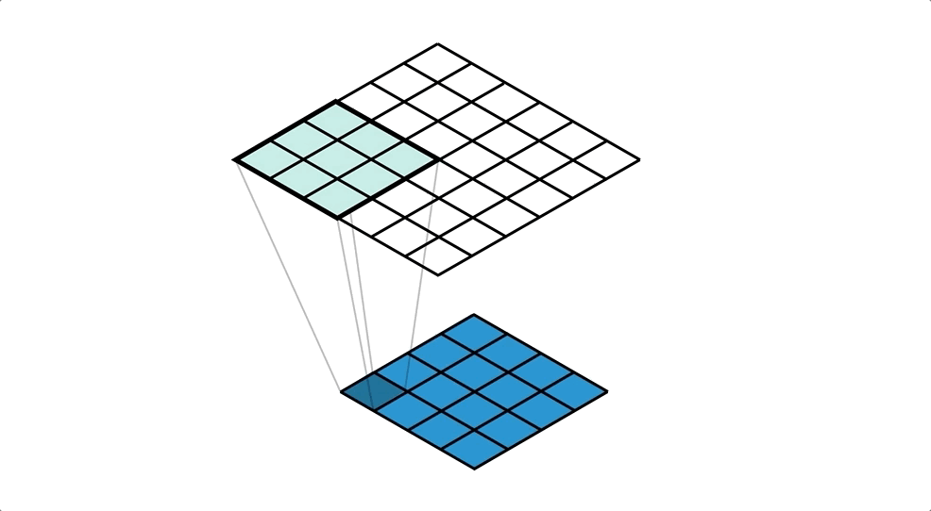
Figure Credit: https://medium.com/apache-mxnet/transposed-convolutions-explained-with-ms-excel-52d13030c7e8

Slide 41
Transposed Convolution
https://distill.pub/2016/deconv-checkerboard/

Slide 42
Semantic Segmentation Idea: Fully Convolutional
Downsampling:
Pooling, strided convolution
Design network as a bunch of convolutional layers, with downsampling and upsampling inside the network!
Upsampling:
Unpooling or strided transpose convolution
Med-res:
D₂ x H/4 x W/4
Med-res:
D₂ x H/4 x W/4
Low-res:
D₃ x H/4 x W/4
Input:
3 x H x W
High-res:
D₁ x H/2 x W/2
High-res:
D₁ x H/2 x W/2
Predictions:
H x W
Long, Shelhamer, and Darrell, “Fully Convolutional Networks for Semantic Segmentation”, CVPR 2015 Noh et al, “Learning Deconvolution Network for Semantic Segmentation”, ICCV 2015
Slide Credit: Fei-Fei Li, Justin Johnson, Serena Yeung, CS 231n

Slide 43
In-Network upsampling: “Unpooling”
Nearest Neighbor
“Bed of Nails”
1 | 0 | 2 | 0
0 | 0 | 0 | 0
3 | 0 | 4 | 0
0 | 0 | 0 | 0
1 | 1 | 2 | 2
1 | 1 | 2 | 2
3 | 3 | 4 | 4
3 | 3 | 4 | 4
1 | 2
3 | 4
1 | 2
3 | 4
Input: 2 x 2
Output: 4 x 4
Input: 2 x 2
Output: 4 x 4
Slide Credit: Fei-Fei Li, Justin Johnson, Serena Yeung, CS 231n

Slide 44
Why this operation?

Slide 45
What is deconvolution?
(Non-blind) Deconvolution

Slide 46
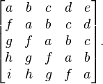
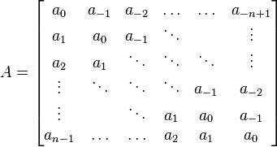
Toeplitz Matrix
Diagonals are constants
A_{ij} = a_{i-j}

Slide 47
Why do we care?
(Discrete) Convolution = Matrix Multiplication
with Toeplitz Matrices
. . .

Slide 48


"Convolution of box signal with itself2" by Convolution_of_box_signal_with_itself.gif: Brian Ambergderivative work: Tinos (talk) - Convolution_of_box_signal_with_itself.gif. Licensed under CC BY-SA 3.0 via Commons - https://commons.wikimedia.org/wiki/File:Convolution_of_box_signal_with_itself2.gif#/media/File:Convolution_of_box_signal_with_itself2.gif

Slide 49

Figure Credit: Dumoulin and Visin, https://arxiv.org/pdf/1603.07285.pdf

Slide 50
What is deconvolution?
(Non-blind) Deconvolution
. . .

Slide 51
What does “deconvolution” have to do with “transposed convolution”?

Slide 52
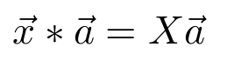
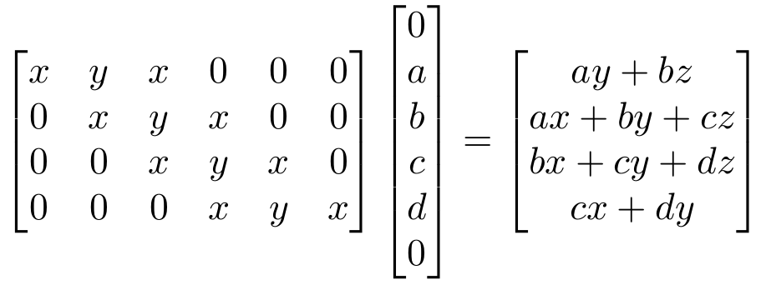
“transposed convolution” is a convolution!
We can express convolution in terms of a matrix multiplication
Example: 1D conv, kernel size=3, stride=1, padding=1
Slide Credit: Fei-Fei Li, Justin Johnson, Serena Yeung, CS 231n

Slide 53
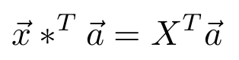
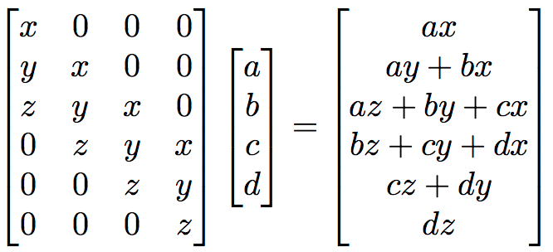
“transposed convolution” is a convolution!
We can express convolution in terms of a matrix multiplication
Convolution transpose multiplies by the transpose of the same matrix:
Example: 1D conv, kernel size=3, stride=1, padding=1
Slide Credit: Fei-Fei Li, Justin Johnson, Serena Yeung, CS 231n

Slide 54
“transposed convolution” is a convolution!
We can express convolution in terms of a matrix multiplication
Convolution transpose multiplies by the transpose of the same matrix:
Example: 1D conv, kernel size=3, stride=1, padding=1
When stride=1, convolution transpose is just a regular convolution (with different padding rules)
Slide Credit: Fei-Fei Li, Justin Johnson, Serena Yeung, CS 231n

Slide 55
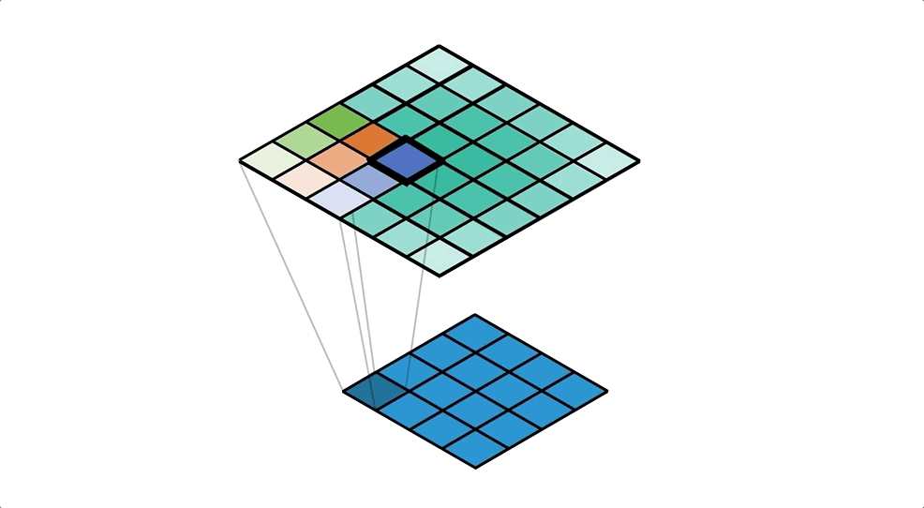
Figure Credit: https://medium.com/apache-mxnet/transposed-convolutions-explained-with-ms-excel-52d13030c7e8

Slide 56
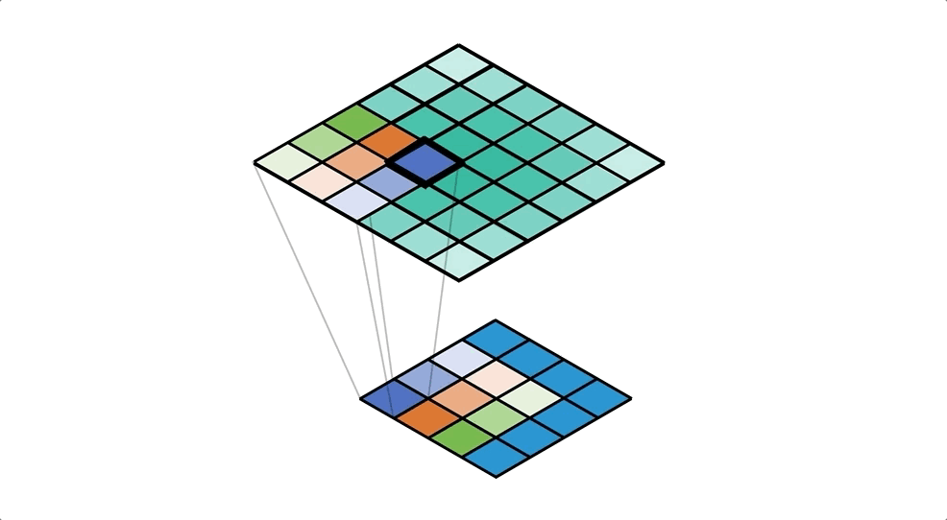
Figure Credit: https://medium.com/apache-mxnet/transposed-convolutions-explained-with-ms-excel-52d13030c7e8

Slide 57
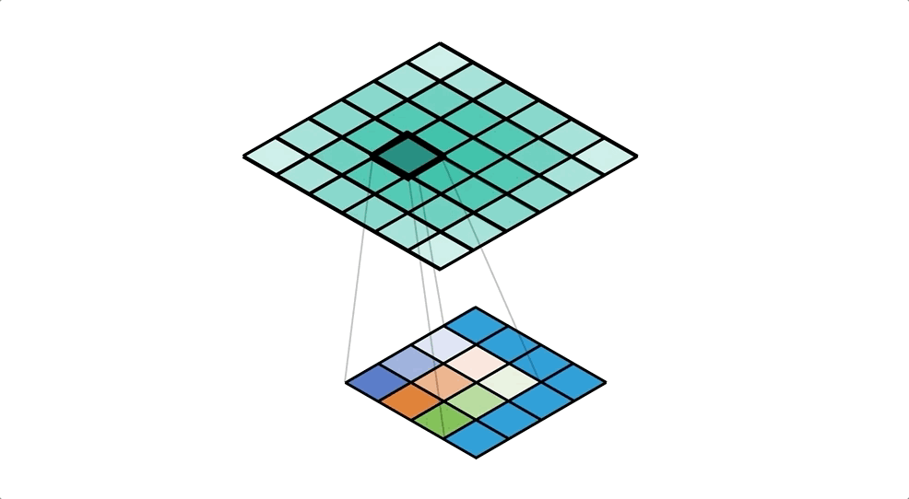
Figure Credit: https://medium.com/apache-mxnet/transposed-convolutions-explained-with-ms-excel-52d13030c7e8

Slide 58
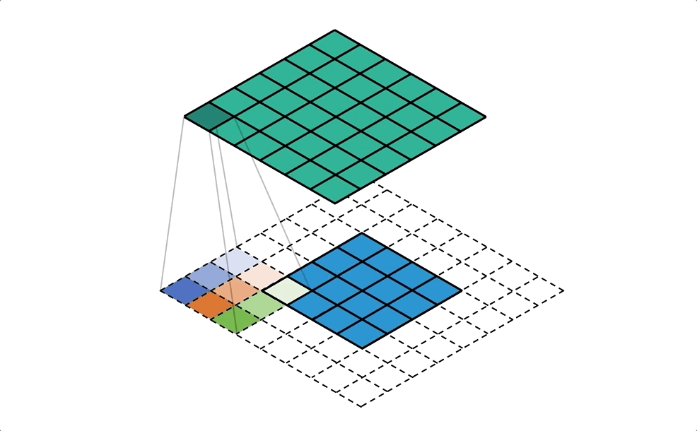
Figure Credit: https://medium.com/apache-mxnet/transposed-convolutions-explained-with-ms-excel-52d13030c7e8

Slide 59
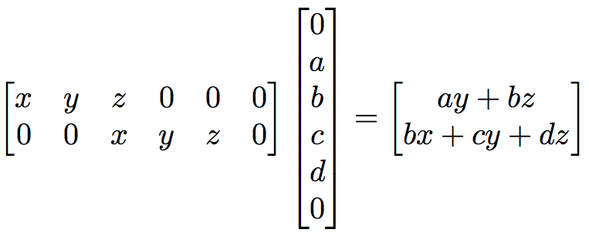
But not always
We can express convolution in terms of a matrix multiplication
Example: 1D conv, kernel size=3, stride=2, padding=1
Slide Credit: Fei-Fei Li, Justin Johnson, Serena Yeung, CS 231n

Slide 60
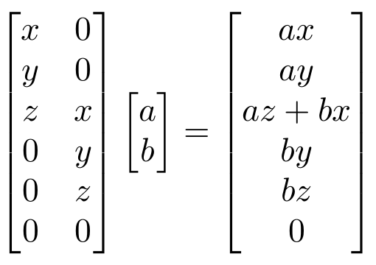
But not always
We can express convolution in terms of a matrix multiplication
Convolution transpose multiplies by the transpose of the same matrix:
Example: 1D conv, kernel size=3, stride=2, padding=1
When stride>1, convolution transpose is no longer a normal convolution!
Slide Credit: Fei-Fei Li, Justin Johnson, Serena Yeung, CS 231n

